Slide 1


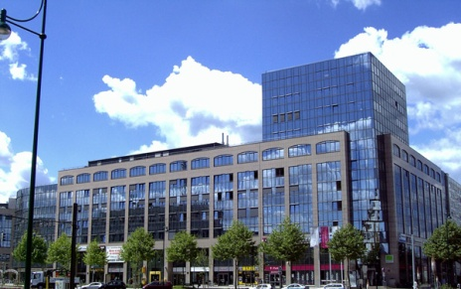
Data Generator for SAP Solutions using Benerator Tool
Supervised by Tim Böttcher
Baba Pakruddin Tailor
Julian Reddy Allam
Naga Sai Krishna Ayinampudi
Sai Rajesh Vanimireddy

Slide 2

Introduction
Agenda:
1) Aim for data generation
2) Global bike INC.
3) Literature research
4) Benerator configuration
5) Generating data and Analysis
6) Conclusion
7) References

Slide 3
Introduction
AIM FOR DATA GENERATION

Slide 4
Aim For Data Generation:
Real-world data is often subject to several privacy constraints.
Under these constraints, researchers often resort to generate data to verify the efficacy.
The generated data must be realistic and correct in terms of size and distributions.
Methods of generating datasets for diﬀerent purposes can be quite diﬀerent.
Our work concentrates on generation of test instances to analyze business process.

Slide 5
Aim For Data Generation:
Realistic represents things in a way that is accurate and true to life.
Synthetic (of a proposition) having truth or falsity determinable by recourse to experience.
Synthetic data generators allow us to generate large volumes of data with well-understood characteristics.
We can easily vary the characteristics of the generated data by varying the input parameters of the data generator.

Slide 6
Introduction
Global Bike INC.

Slide 7
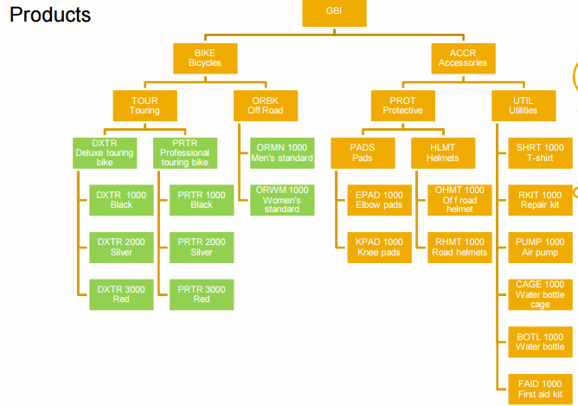
Global Bike INC. :
GBI is an eminent bicycle company producing bikes and accessories for both touring and off-road racing.
Source: GBI material.

Slide 8
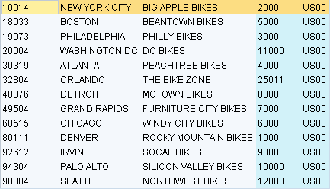
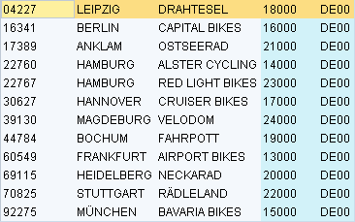
Global Bike INC. :
CUSTOMERS
Source: GBI material.

Slide 9
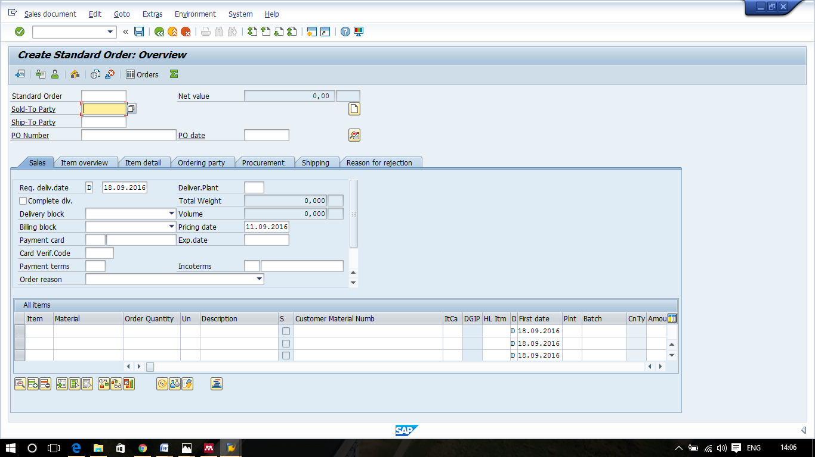
Global Bike INC. :
SALES ORDER CREATION IN ERP :

Slide 10
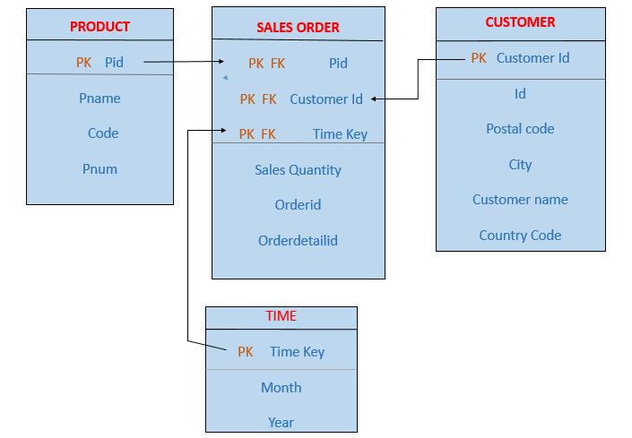
Global Bike INC. :
DATA MODEL:

Slide 11
Introduction
Literature Research

Slide 12
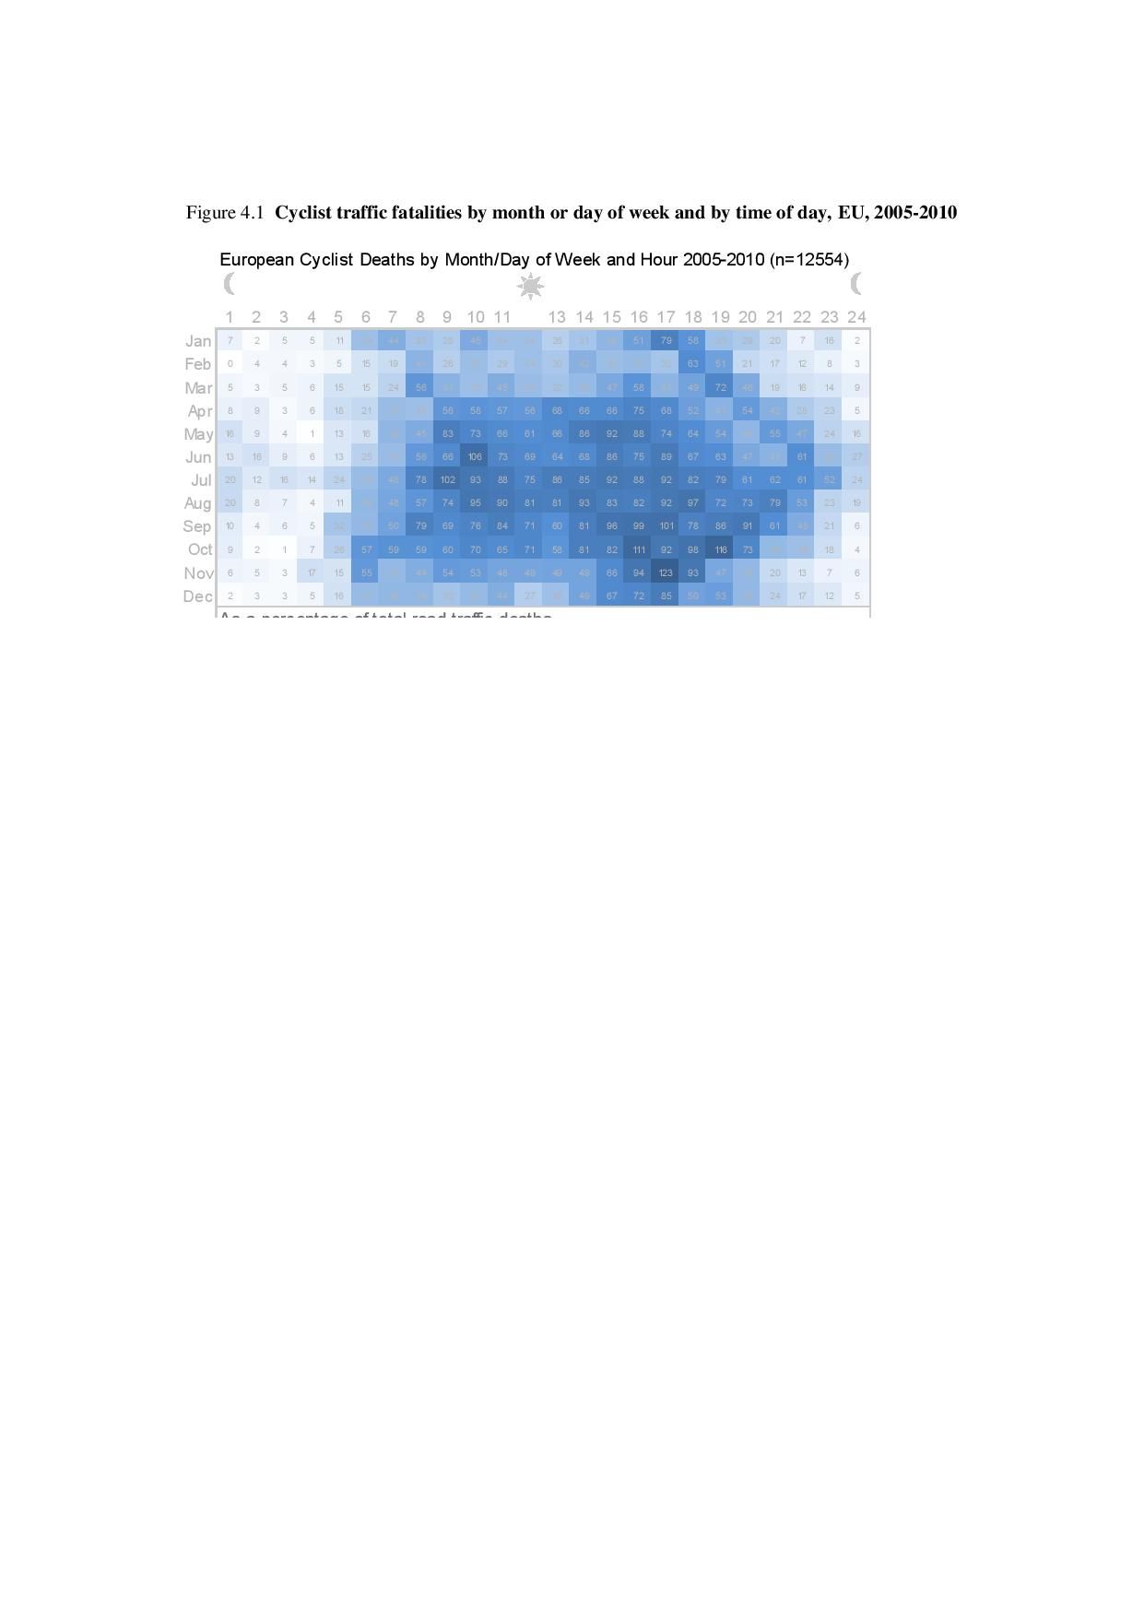
Literature Research:
In order to generate realistic data we have researched for certain rules which affects the sales.
MONTHLY DISTRIBUTION:
Source: OECD/International transport forum.

Slide 13
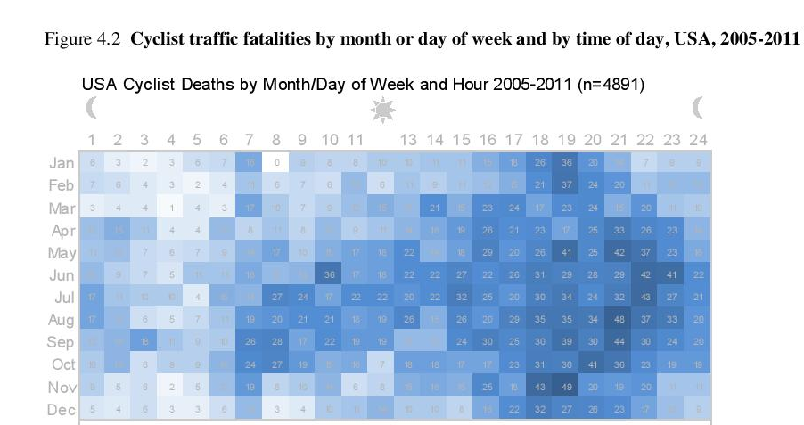
MONTHLY DISTRIBUTION:
Source: OECD/International transport forum.

Slide 14
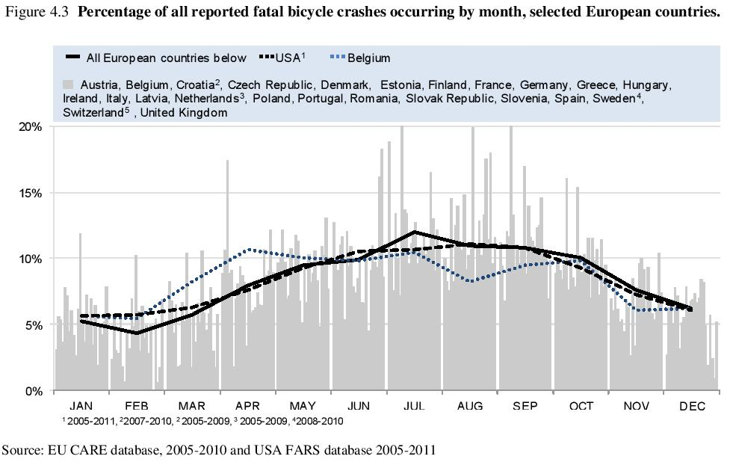
MONTHLY DISTRIBUTION:
Source: OECD/International transport forum.

Slide 15
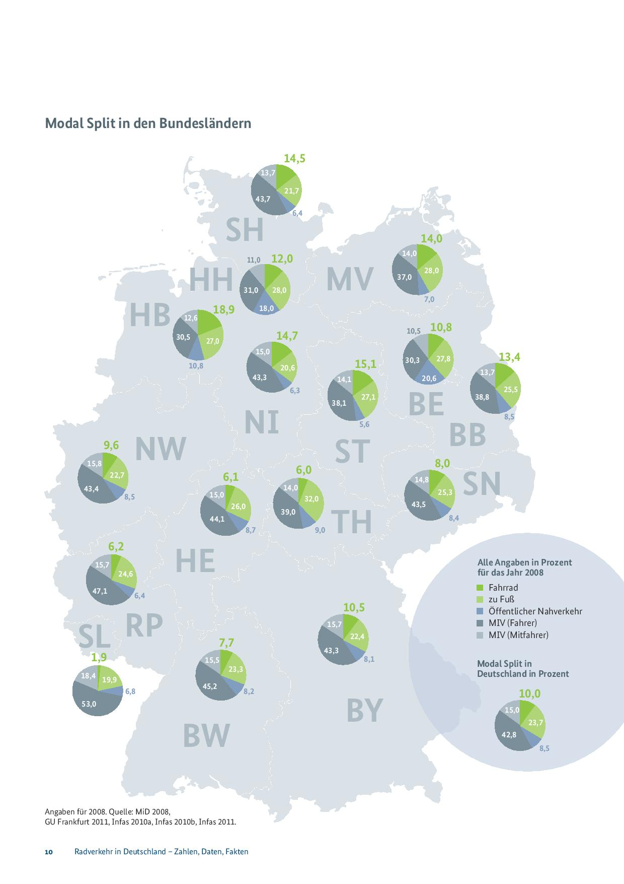
DISTRIBUTION BY CITIES:
Source: Radverkehr in Deutschland zahlen, Daten, Fakten.

Slide 16
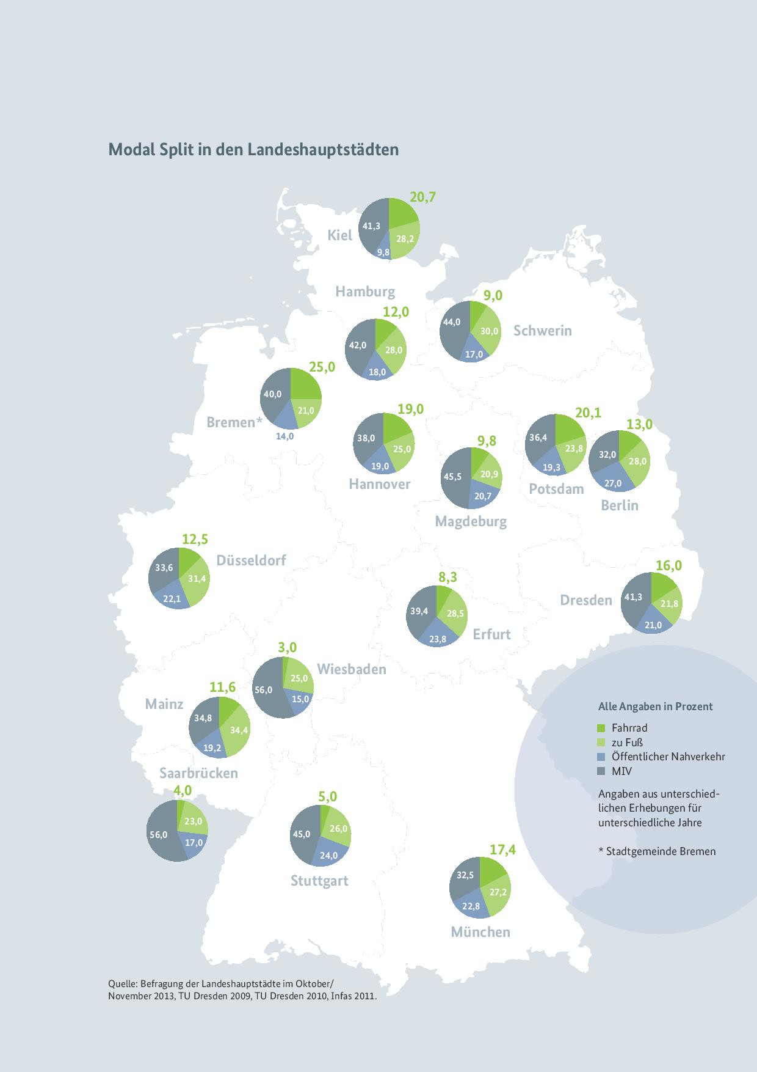
DISTRIBUTION BY CITIES:
Source: Radverkehr in Deutschland zahlen, Daten, Fakten.

Slide 17
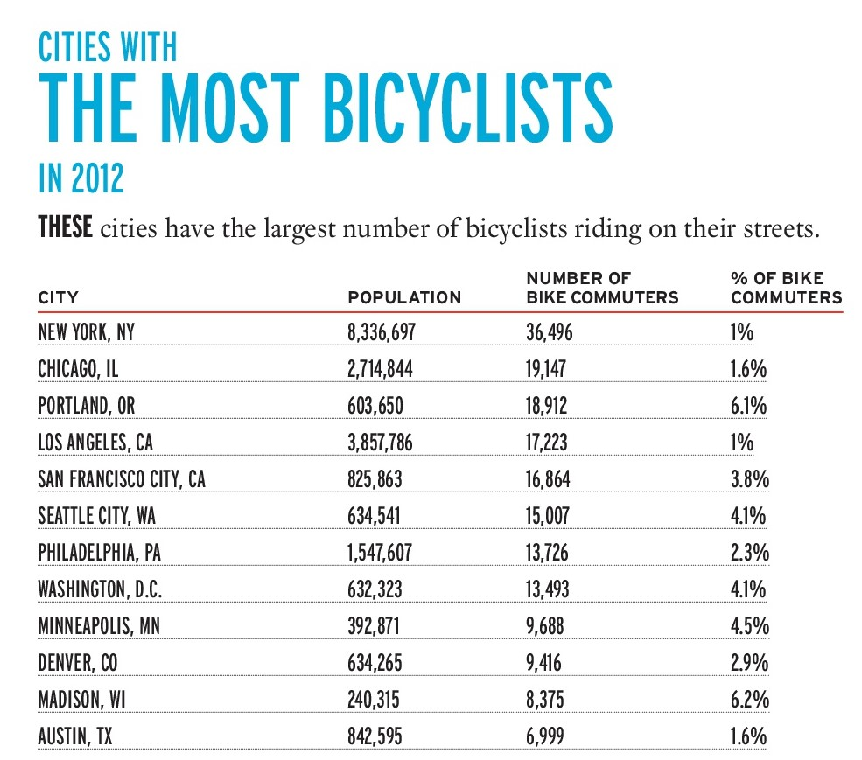
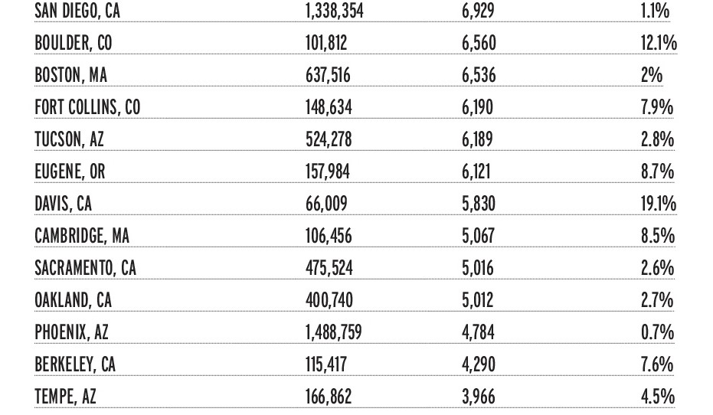
Literature Research:
DISTRIBUTION BY CITY:
Source: 2013 American Community Survey data report.

Slide 18
Literature Research:
Sales distribution per gender.
Colour preferences.
Percentage of sales by bikes, parts and accessories.
YEARLY DISTRIBUTION:
Population variation from 2009-2011.
Number of bike users in particular year.
PRODUCT DISTRIBUTION:

Slide 19
Introduction
Benerator Configuration

Slide 20
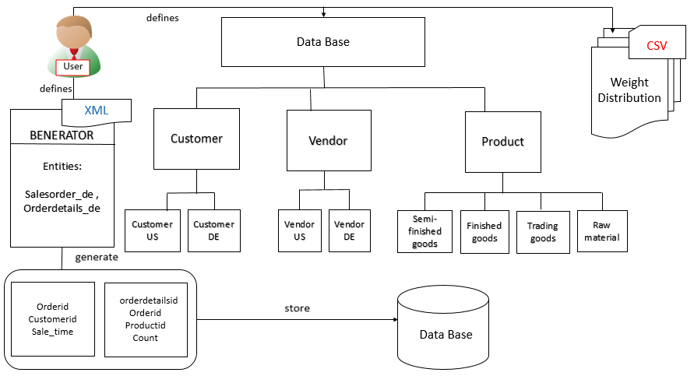
Benerator Configuration:
OVERVIEW:

Slide 21
Benerator Configuration:
DESCRIPTOR.XML FILE:
Populating Database
Creating Tables
Date Specification
Generating Entities and Analysing

Slide 22
Benerator Configuration:
POPULATING DATABASE: Establishing connection for data base.
<database id=“db”
url=“jdbc:mysql://localhost:3306/datagenerator”
Driver=“com.mysql.jdbc.Driver”
schema=“datagenerator”
catalog=“datagenerator”
user=“*****”
password=“*******”/>

Slide 23
Benerator Configuration:
Orderdetails Table:
<execute target="db" >
create table ordersdetails(
orderdetailid int unique AUTO_INCREMENT,
productid int,
orderid int,
count int)
</execute>
CREATING TABLES: Tables are created to assign a path for generating entities.
Salesorders Table:
<execute target="db" >
create table salesorders(
orderid int AUTO_INCREMENT,
customerid int,
sale_time varchar(100),
PRIMARY KEY(orderid))
</execute>

Slide 24
Benerator Configuration:
Date Specification : Each month is specified with unique identity using bean classes to define them globally.
Example: Date specification for January 2009
<bean id="dtGen0901" class="DateTimeGenerator">
<property name='minDate‘ value='2009-01-01'/>
<property name='maxDate' value='2009-01-31'/>
<property name='dateGranularity' value='00-00-01' />
</bean>
---------------

Slide 25
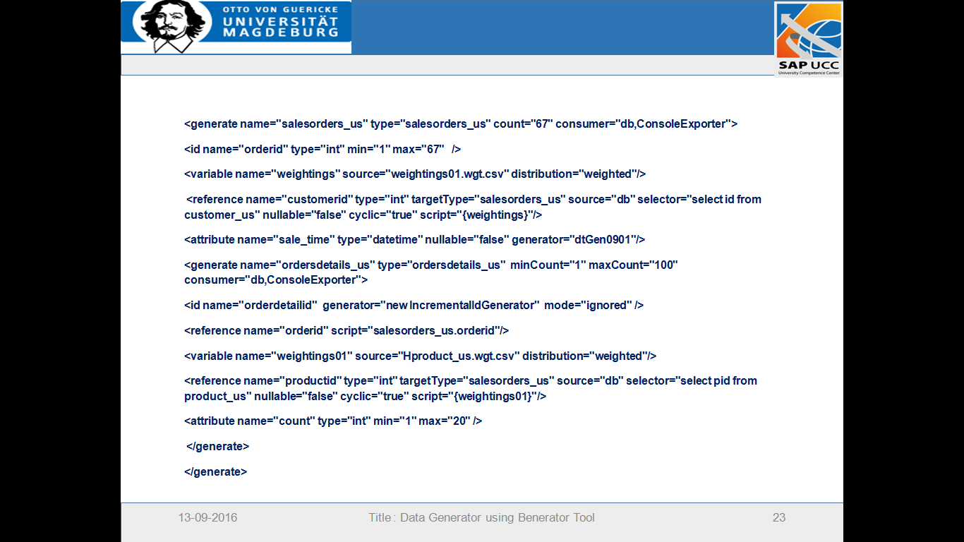
Benerator Configuration:
Generating Entities : Entities can be generated as per user requirement.
------------

Slide 26
Introduction
Generating Entities and Analysis

Slide 27
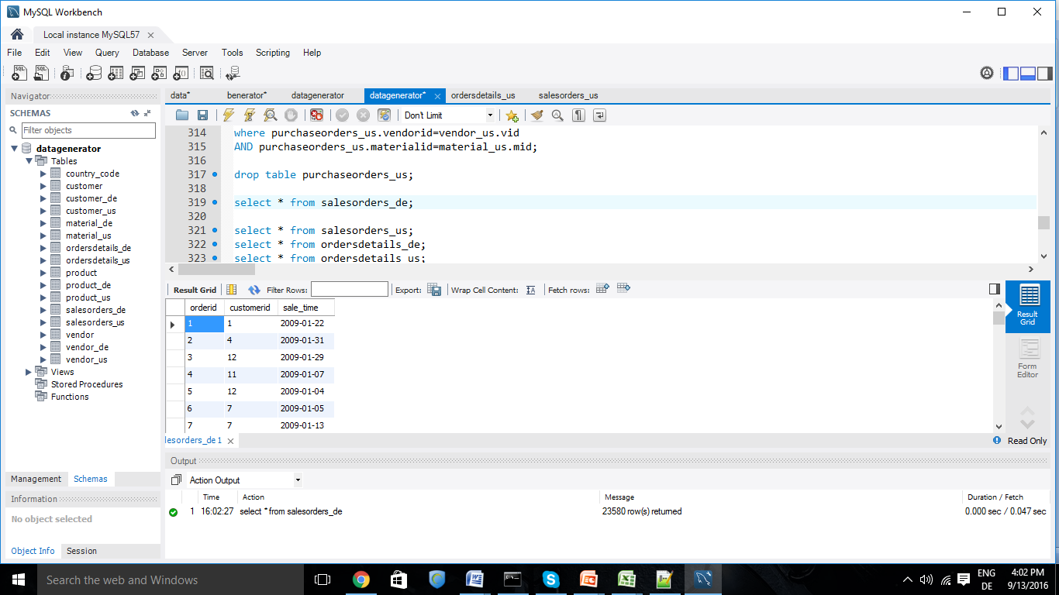
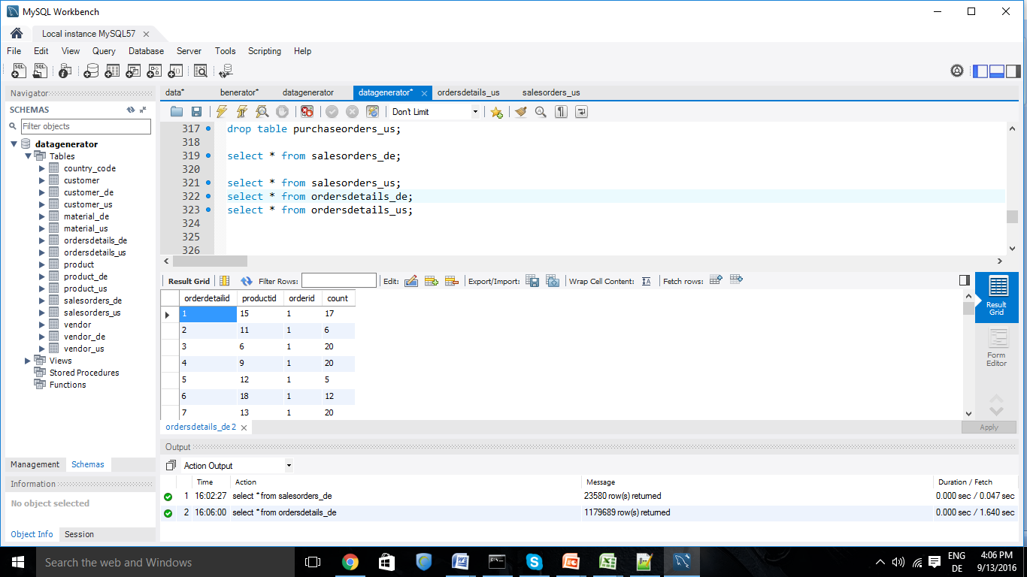
Generating Entities and Analysis:
TABLES CREATED:
Salesorders Table:
Orderdetails Table:

Slide 28
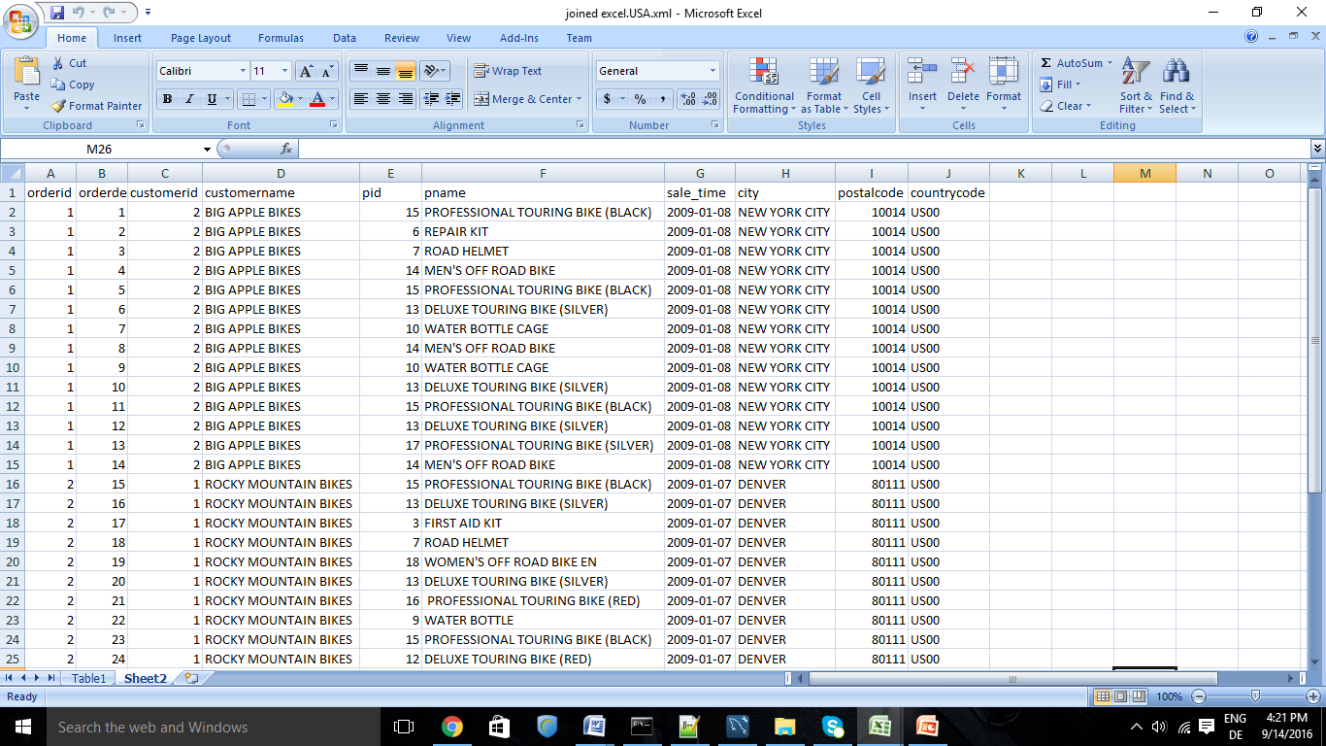
Generating Entities and Analysis:
JOIN clause is used to combine Product, Customer, Salesorders, Orderdetails tables to return required rows in sales-order table.

Slide 29
Generating Entities and Analysis:
Analysis were done as per generated data.

Slide 30
Generating Entities and Analysis:
Analysis were done as per generated data.

Slide 31
Generating Entities and Analysis:
Analysis were done as per generated data.

Slide 32
Generating Entities and Analysis:
Analysis were done as per generated data.

Slide 33
Generating Entities and Analysis:
Analysis were done as per generated data.

Slide 34
Introduction
Performance and Limitations

Slide 35
Performance and Limitations:
PERFORMANCE:
Performance of benerator was tested for different number of datasets generated.
Generating time increases as the number of entities to be generated increases.

Slide 36
Performance and Limitations:
Development for the tool ended in 2009, with release v 0.9.8.
• The online forum is inactive and no longer accepts registrations.
The documentation is not exhaustive enough to cover all use cases.
LIMITATIONS:

Slide 37
Introduction
Conclusion

Slide 38
Conclusion:
We have generated systematic data sets, which were organized in format using benerator tool, and data is extracted in Excel sheet. Later we have analyzed the data of increment and decrement in sales as per seasonal conditions, city wise distribution of bikes sales. Also found the differences of sales in Germany and in the USA on different time scales. These output realistic datasets can be used for analysis purposes.

Slide 39
Introduction
References

Slide 40
References:
[1] V. Ayala-Rivera, P. McDonagh, T. Cerqueus, L. Murphy, Synthetic data generation using benerator tool, arXiv preprint arXiv:1311.3312 (2013).
[2] P. K ”u nzel, The radschnellweg regio velo 01 nsterland in westm ”u. route, use, planning and financing .
[3] K. McLeod, D. Flusche, A. Clarke, Where we ride: Analysis of bicycling in American cities (2013).
[4] B. G. G. B. F. F. H. I. T. N. P. S. S. Members of national Bicycle Industry Associations in 14 different countries: Austria, Belgium, Turkey., European bicycle market (2015) 10–75.
[5] C. Emond, W. Tang, S. Handy, Explaining gender differences in bicycle behavior, in: Active Living Research Conference February, volume 19.

Slide 41
References:
[6] M. Nezhad, K. Kavehnezhad, et al., Choosing the right color: a way to increase sales, International Journal of Asian Social Science 3 (2013) 1442–1457.
[7] J. A. Bellizzi, R. E. Hite, Environmental color, consumer feelings, and purchase likelihood, Psychology & marketing 9 (1992) 347–363.
[8] N. Torslov, Cycling,health and safety, OECD/International Transport Forum(2013),Cycling,Health and Safety OECD Publishing/ITF.
[9] Houkjr, Kenneth, Kristian Torp, and Rico Wind. ”Simple and realistic data generation.” Proceedings of the 32nd international conference on Very large data bases. VLDB Endowment, 2006.

Slide 42
References:
[10] Gabriel Ghinita, Yufei Tao, and Panos Kalnis. On the Anonymization of Sparse High-Dimensional Data. In ICDE, pages 715724. Ieee, April 2008.
[11] Lu, Qing Chang, et al. ”Inter-city travel behavior adaptation to extreme weather events.” Journal of Transport Geography 41 (2014): 148-153.
[12] Cui, Yuchen, Sabyasachee Mishra, and Timothy F. Welch. ”Land use effects on bicycle ridership: a framework for state planning agencies.” Journal of Transport Geography 41 (2014): 220-228.
[13] Phung, Justin, and Geoff Rose. ”Temporal variations in usage of Melbourne’s bike paths.” Proceedings of 30th Australasian Transport Research Forum, Melbourne . Of 2007.

Slide 43
References:
[14] Brandenburg, Christiane, Andreas Matzarakis, and Arne Arnberger.
“Weather and cycling-a first approach to the effects of weather conditions on cycling”Meteorological applications (2007): 61-67.
[15] Whiting, Mark A., Jereme Haack, and Carrie Varley. ”Creating realistic, scenario-based synthetic data for test and evaluation of information analytics software.” Proceedings of the 2008 Workshop on BEyond time and errors: novel evaLuation methods for Information Visualization. ACM, 2008.
[16] T Varga and Horst Bunke. Generation of synthetic training data for an HMM-based handwriting recognition system. Document Analysis and Recognition, 2003.

Slide 44


